Slide 1
Diabetes Progression Insights Dashboard
File created on: 2/20/2025 5:02:38 AM

Slide 2
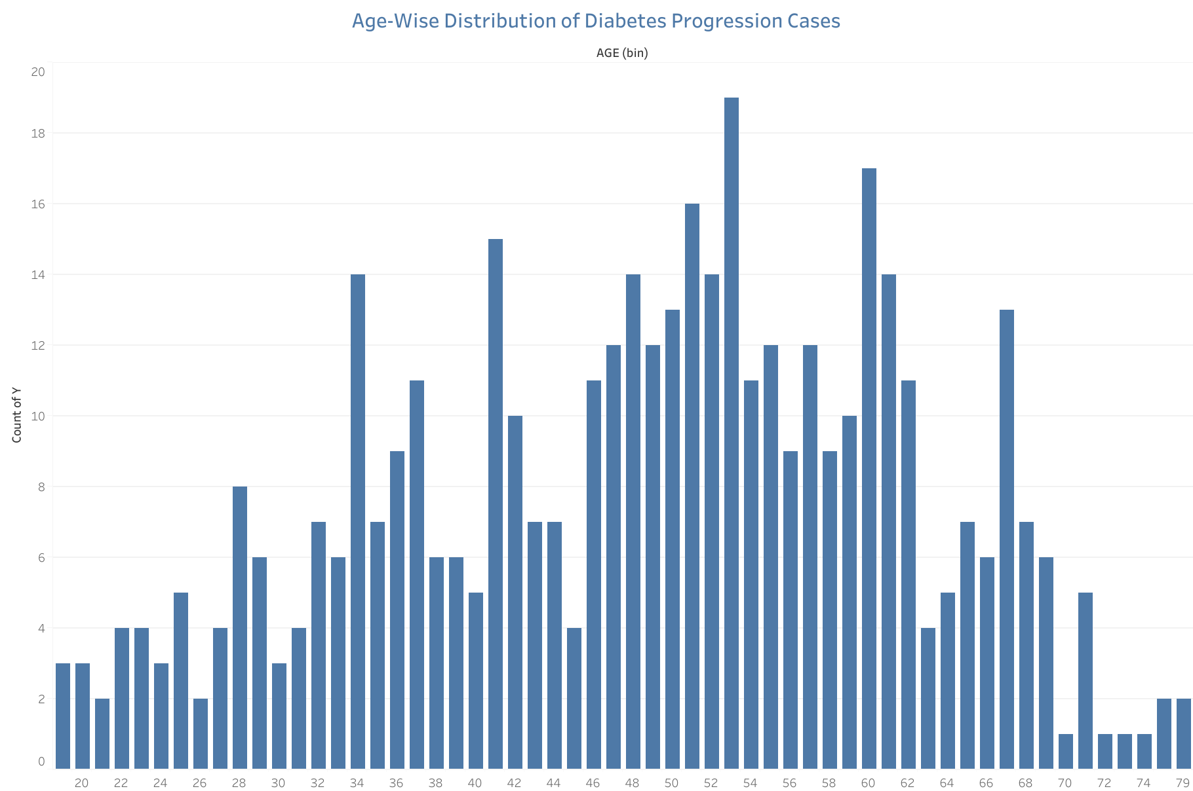

Slide 3


Slide 4
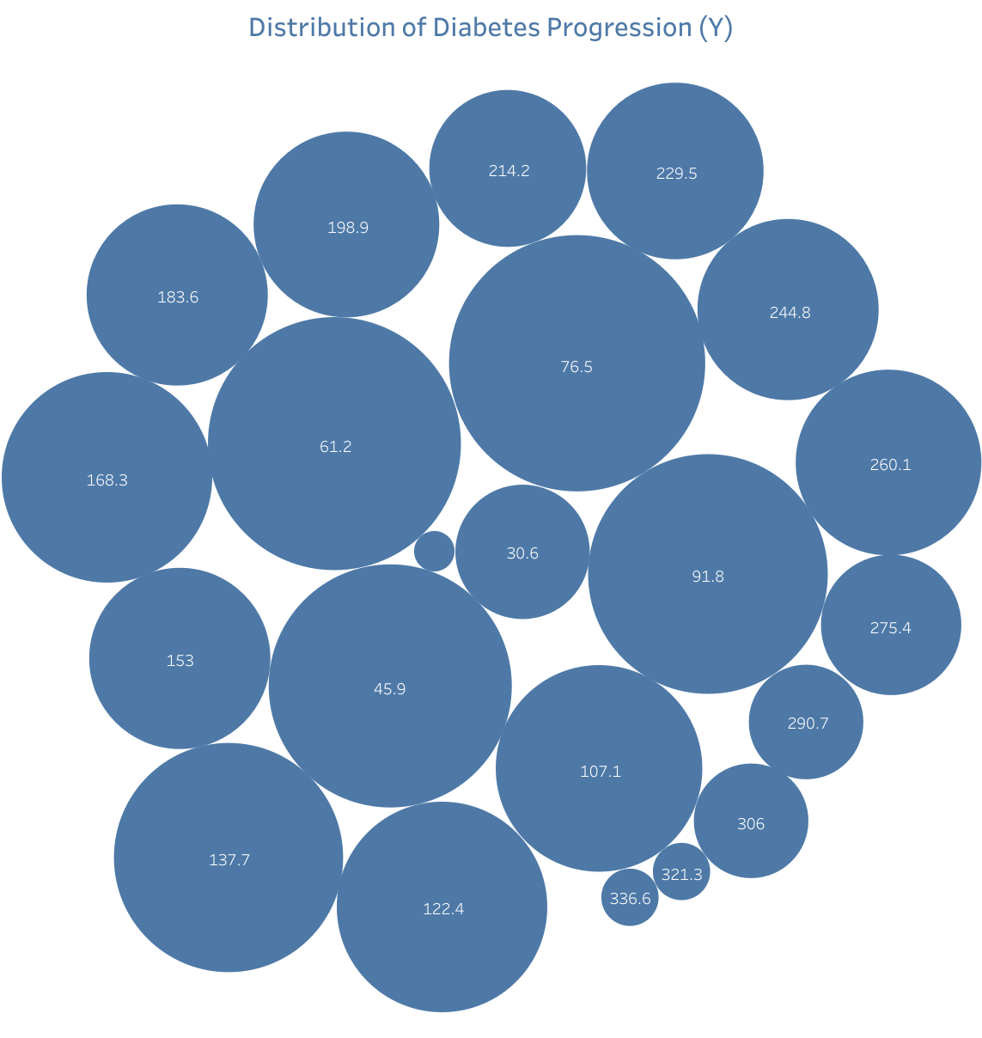

Slide 5


Slide 6
